Slide 1
Requirements engineering processes

Slide 2
Requirements engineering processes may include four iterative high-level activities.
feasibility study: Is the system useful
elicitation and analysis: discovering requirements
Specification:converting requirements to standard form
Validation:checking if requirements actually define the system that the customer wants

Slide 3
Requirements elicitation and analysis
Requirements elicitation and analysis is the first step in requirements engineering.
Requirements elicitation: involves software engineers working with customers and system end-users to find out the functionalities and non-functional requirements of the system.
Requirement analysis: determines the needs or conditions to be meet and, taking account of the possibly conflicting requirements of the various stakeholders.

Slide 4
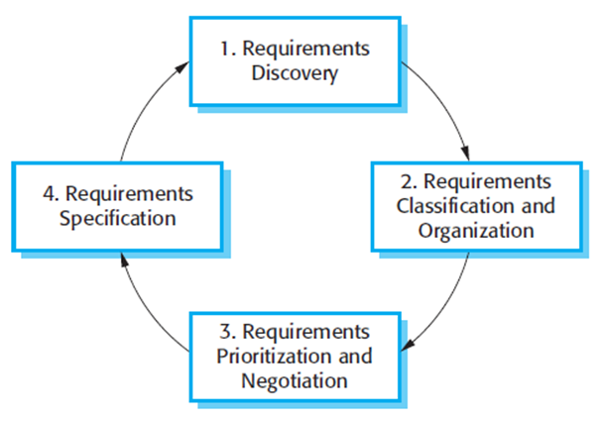
requirement elicitation and analysis process
requirement discovery,
requirement classification and organization,
requirement prioritization and negotiation
requirement specification.

Slide 5
Some techniques used for gathering requirements
Brainstorming
Document Analysis/ Gap Analysis: requirements left out accidently
Focus Group: gathering of small but diverse group of stakeholders to elicit opinions on the requirements.
Interface Analysis: ensuring that the components interact with one another effectively
Interview: sit down with the clients and ask them what they need
Ethnography: analyst immerses himself or herself into the day-to-day working environment
Use case
JAD Session (Joint Application Development)
Survey/ Questionnaire

Slide 6
Techniques for analyzing requirements include:
Each requirement can be prioritized and assigned to a team member to be worked on.
Financial properties can be attributed.
Hierarchical structures can be created(requirements trees).
Collaborate on requirements with your team by holding discussions, entering details and attaching files for each requirement.
Turn requirements into tasks or issues.

Slide 7
HP ALM- Hewlett Packard Application Life Cycle management
Jira
Rally
MSTFS-Team Foundation Server
MS Office (MS Word, MS Excel, MS Power point, MS Visio)
Trello
Onedesk

Slide 8
Requirements validation (Different types of checks)
Requirements validation is important because errors in a requirements document can lead to extensive rework costs when these problems are discovered during development or after the system is in service. Different types of checks:
Validity checks A user may think that a system is needed to perform certain functions. However, further thought and analysis may identify additional or different functions that are required.
Consistency checks Requirements in the document should not conflict.
Completeness checks The requirements document should include requirements that define all functions and the constraints intended by the system user.
Realism checks Using knowledge of existing technology, the requirements should be checked to ensure that they can actually be implemented.
Verifiability To reduce the potential for dispute between customer and contractor, system requirements should always be written so that they are verifiable(Testable).

Slide 9
There are a number of requirements validation techniques
Requirements reviews The requirements are analyzed systematically by a team of reviewers who check for errors and inconsistencies.
Prototyping an executable model of the system in question is demonstrated to end-users and customers.
Test-case generation Requirements should be testable. If a test is difficult or impossible to design, this usually means that the requirements will be difficult to implement and should be reconsidered.

Slide 10
The software requirements document
The software requirements document (sometimes called the software requirements specification or SRS) is an official documentation of what the system developers should implement.
SRS= user requirements + system requirements
Ideally, the user and system requirements should be clear, unambiguous, easy to understand, complete, and consistent.

Slide 11
ser requirements
The user requirements for a system should describe the functional and non-functional requirements so that they are understandable by system users who don’t have detailed technical knowledge.
Requirement specification can be done using natural language and/or structure approach

Slide 12
The important properties of a good SRS document are the following
Concise. at the same time unambiguous, consistent, and complete.
Structured. It should be well-structured. A well-structured document is easy to understand and modify.
Black-box view. The SRS document should view the system to be developed as black box. This means that the SRS document should specify the external behavior of the system and not discuss the implementation issues.
Conceptual integrity. It should show conceptual integrity so that the reader can easily understand it.
Response to undesired events. It should characterize acceptable responses to undesired events. These are called system response to exceptional conditions.
Verifiable. This means that it should be possible to determine whether or not requirements have been met in an implementation.

Slide 13
FORMAL SYSTEM SPECIFICATION
A formal technique is a mathematical method to specify a hardware and/or software system, verify whether a specification is realizable, verify that an implementation satisfies its specification, prove properties of a system without necessarily running the system, etc. The mathematical basis of a formal method is provided by the specification language.

Slide 14
Formal Specification Language
Formal specification involves the use of formal methods based mathematical approaches to specify software requirements.
They are used to describe a system, analyze its behavior, aid its design by verifying key properties of interest through rigorous and effective reasoning tools.
These specifications are formal in the sense that they have a syntax, their semantics fall within one domain, and they can be used to infer useful information

Slide 15
A formal specification language consists of two sets syn and sem , and a relation between them. The set is called the syntactic domain, the set is called the semantic domain, and the relation sta is called them.

